Slide 1

Management skills for business analysts stakeholders
Ms. Kati Julow

Slide 2

Preliminary preparation
https://www.batimes.com/articles/20-lessons-learnt-over-20-years-of-doing-business-analysis.html
Stakeholder Management case study UK Passport Agency:
https://www.independent.co.uk/travel/news-and-advice/passport-fiasco-cost-pound-13m-with-a-pound-16-000-bill-for-umbrellas-plus-500-spoilt-holidays-739213.html
https://www.stakeholdermap.com/importance-stakeholder-management.html
Some company failures in stakeholder and project management
https://www.workfront.com/blog/project-failure-10-famous-failures-and-5-ways-to-spot-them-before-they-happen

Slide 3

Today’s agenda
BAs need to pinpoint stakeholders. How do we do stakeholder mapping and zoom on how to build trust and relationships with them?(How to position yourself professionally through relationship management?)
Your takeaways and toolset:
Who are stakeholders? Why to bother?
How to prioritize stakeholders?
Power/influence matrix
Jack Ma’s approach
Salience
RACI matrix

Slide 4

Group discussion: who are stakeholders?
Notes:
What conflicts they may have

Slide 5
Who holds the budget? Who owns the profit and loss?
Who owns the relationship with the customer?
Who signed up to the business case? Who will report on the KPIs?
Who will be providing resources, people and equipment? Who seems to have a keen interest? Is this a pet project for someone?
Who will stand to lose their job if this project doesn't work out? Who will get promoted if this goes well?
Who will build/is building their reputation on this?
Who will report to the board/most senior committee on progress?
Who will end up in court if this goes wrong?
Source: Stakeholder Analysis - Key Players [you can't ignore] https://www.stakeholdermap.com/stakeholder-analysis/Stakeholder-Analysis-keyplayers.html

Slide 6
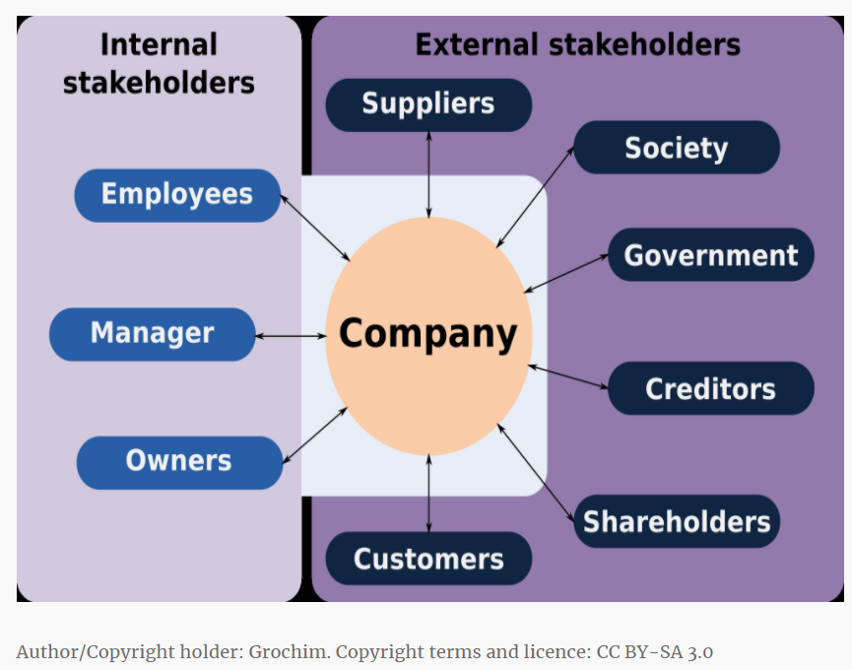
Who are stakeholders?
Interested & counterinterested parties
Help or hinder
Assess their influence/importance
https://www.interaction-design.org/literature/article/stakeholder-maps-keep-the-important-people-happy

Slide 7
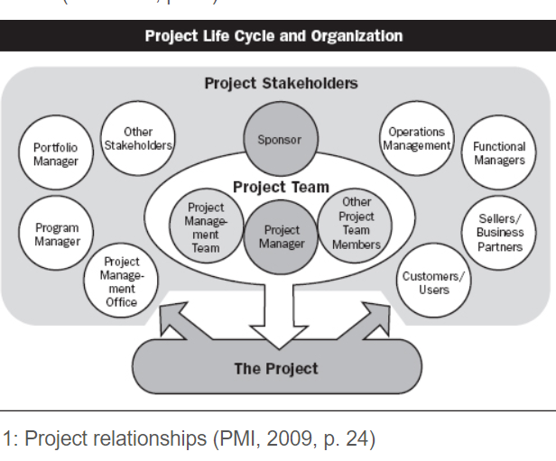
Stakeholders in project management
https://www.pmi.org/learning/library/stakeholder-management-keeping-stakeholders-happy-6697

Slide 8

„project YOU”
Exercise about understandoing our stakeholers
Pick a project that is important for you right now

Slide 9
Group discussion: do stakeholders rank similarly?
Notes:
What conflicts they may have

Slide 10
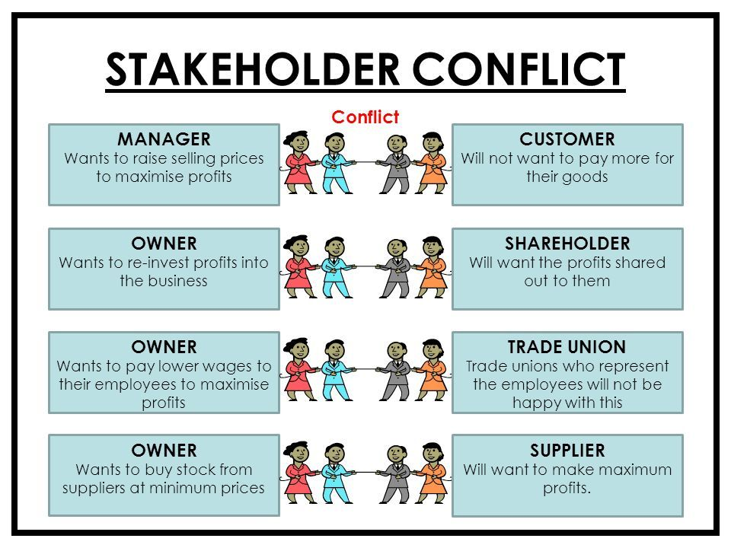
What is a stakeholder conflict
problem: numerous stakeholders with different interests
No alignment, may conflict
Business myopia: short-term profits vs.long term
Distrust in outsiders: family owned vs. Managers
Risk appetite: funding needs vs. Financial risk
Stock market shy: exposure ?
Low the bar: go mass –reduce quality?
Headquarter vs. Local
Notes:
Since labor costs are unavoidable for most companies, a company may seek to keep these costs under tight control. This is likely to upset another group of stakeholders, its employees.

Slide 11

What is a shareholder primacy?
Friedmanian approach: maximize profits & shareholder value
Shareholder primacy :shareholder-centric governance / maximize the value of shareholders before considering other stakeholders,
CEO/Board/management determine the ranking of stakeholders (incl competing interests .
Learning: manage stakeholder needs
Notes:
Since labor costs are unavoidable for most companies, a company may seek to keep these costs under tight control. This is likely to upset another group of stakeholders, its employees.
Friedmanian approach: e.g.to maximize profits and enhance shareholder value
Shareholder primacy :shareholder-centric form of corporate governance that focuses on maximizing the value of shareholders before considering the interests of other stakeholders, such as society, the community, consumers, and employees.
At the end of the day, it’s up to a company, the CEO, and the board of directors to determine the appropriate ranking of stakeholders when competing interests arise.
Business life cycle determines stakeholder ranking (e.g. startups-customers & employess; mature company-shareholders)
Learning: manage stakeholder needs

Slide 12
Group discussion: how to manage stakeholder needs?
Notes:
What conflicts they may have

Slide 13
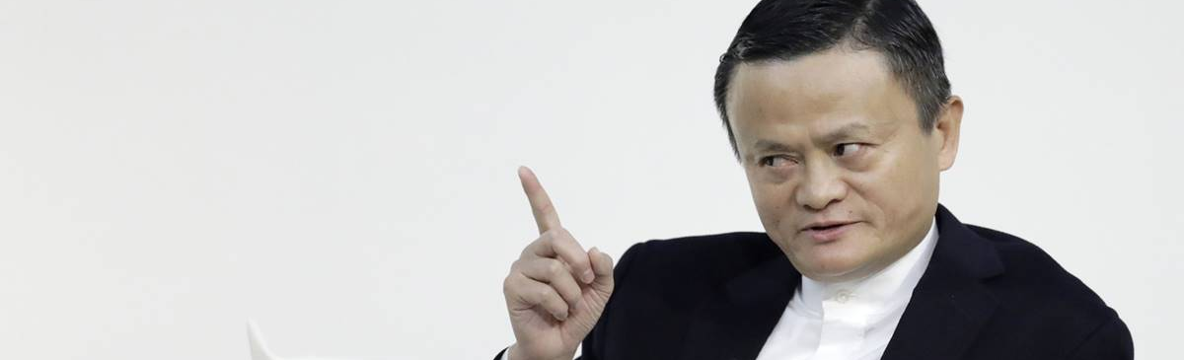
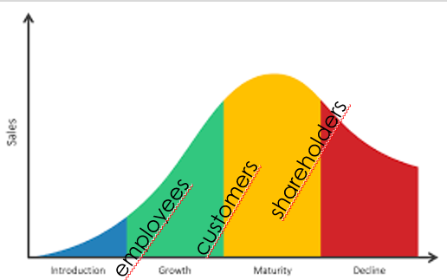
How to manage stakeholders? Jack Ma’s recipe
Business life cycle determines stakeholder ranking
Learning: assess life-cycle of the business
Notes:
Business life cycle determines stakeholder ranking (e.g. startups-customers & employess; mature company-shareholders)

Slide 14
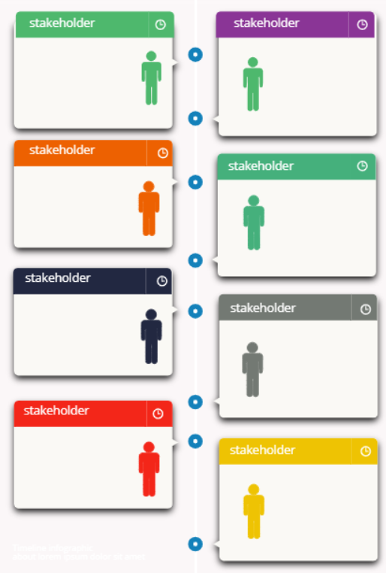
Who are your stakeholders now?
Think through the dimensions (economic, academic, professional, political, ……)
List them

Slide 15
What are their estimated impact on you (influence)?
high
influence
Rank them on the high low axis
low

Slide 16
What are their expectations from you (interest/power)?
high
Rate them
influence
low
high
low
Interest/power

Slide 17
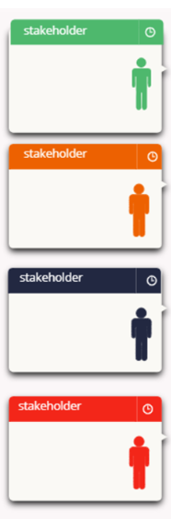
What are their responsibilities?
responsible | accountable | consulted | informed
Create a RACI
Responsible: performs the work (e.g. a business analyst prepares a requirement package)
Accountable: ultimately accountable for the correct task completion/ the one who delegates the task to the responsible. ONE accountable/task! Consulted: expert opinion givers; experts consulted (2 way communication).
Informed: parties who are kept up-to-date via one way communication (e.g. business analyst informs external stakeholders about t X phase completion).
RACI matrix

Slide 18
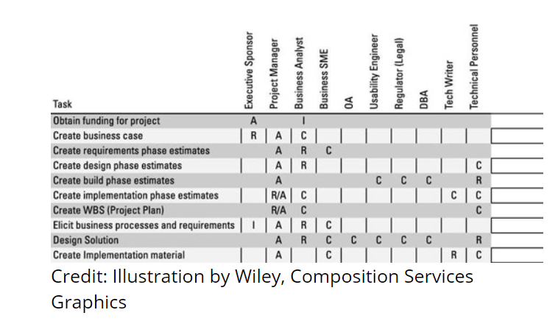
RACI for a design project
Stakeholders can have multiple project roles!
https://www.dummies.com/business/business-strategy/how-to-identify-the-stakeholders-in-your-business-analysis-project/

Slide 19
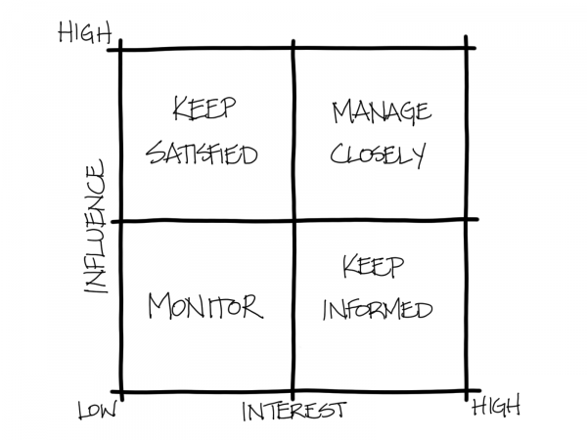
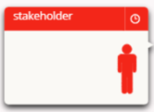
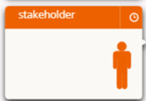
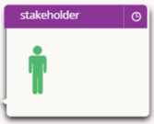
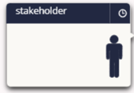
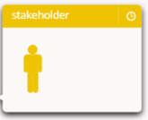
The stakeholder map
When circumstances change, the categories change
Needs regular update

Slide 20
How do you build an „interface” (coalition, support) with them ?
Keep them happy, supportive, interested in project YOU!

Slide 21
Should their expectations/ needs change, what is your requirement change process? What risks may emerge?
Engage and consult
Raise their interest
Involve them in decisions
Engage and consult
them
Keep them trustful, happy, supportive, interested in project YOU!
Inform them
Raise their interest
Involve them in low risk areas
Can be good promoters/advocates

Slide 22
Who are your stakeholders in a year’s time?
Think through the dimensions (economic, academic, professional, political, ……)
List them….

Slide 23
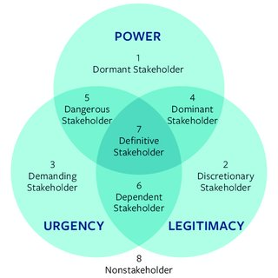
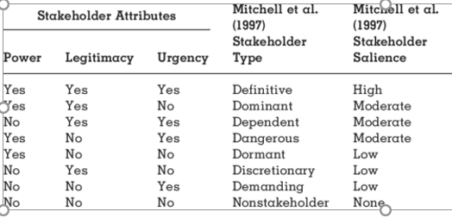
Ability to impose will
Stakeholder salience
Need for immediate reaction
Their involvment is appropriate

Slide 24
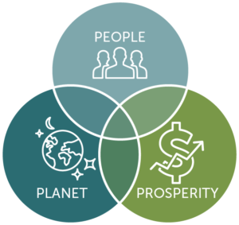
Triple bottom line management (Elkington 1997)
Shift from sole profits to triple bottom line
Changing KPIS and reporting

